Slide 1

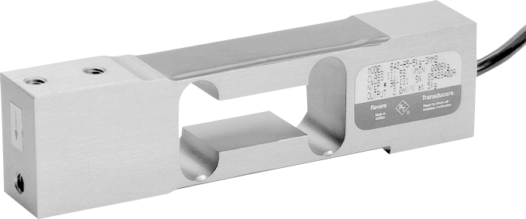
Load Cells
Leann Armbrust
Travis Wyatt
SRJC, Engr 45
Fall 2010
Notes:
introduce selves

Slide 2
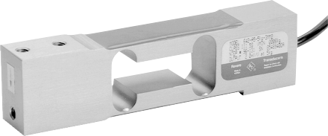


What is a Load Cell?
A load cell is a transducer that is used to convert a force into electrical signal.
The most common type is a strain gauge load cell.
Notes:
• transducer: converts one type of energy to another
• load cell type pictured is a binocular beam type
• mounted on right, weight placed on left
• point out location of strain gauges (can be in various configurations)
• leann talks

Slide 3
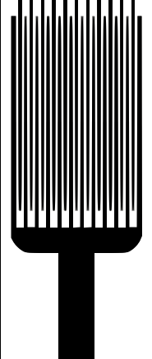
Strain Gauge
What Is It?
A Strain Gauge is a device used to measure the strain of an object.
  The most common type of strain gauge consists of an insulating flexible backing which supports a metallic foil pattern.
Notes:
• an example is shown on the right
• thin lines pattern is the metallic foil show on right
• leann talks

Slide 4
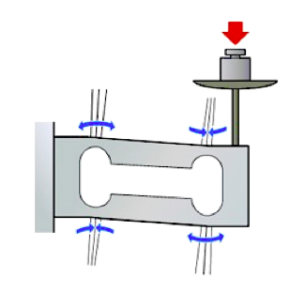
Strain Gauge
Resistance
l
R
ρ
=
A
  Strain Gauge under tension.Resistance goes up.
  Strain Gauge under compression.Resistance goes down.
Notes:
•
•
• leann talks

Slide 5
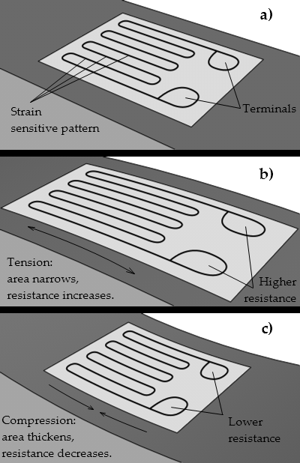
Strain Gauge
How Does It Work?
The gauge is attached to the object by a suitable adhesive.
As the object is deformed, the foil is deformed, causing its electrical resistance to change.
The resistance change is commonly measured using a Wheatstone bridge.
Notes:
•
• leann talks

Slide 6
Wheatstone Bridge
What Is It?
A Wheatstone Bridge is an electrical circuit.
  Used in a load cell to measure an overall change in resistance.
  Increases sensitivity and reduces the affects of temperature.
R1
R4
+
-
VEX
V0
R2
R3
Notes:
• shown on right
• the overall change in resistance is outputted as a voltage (V0)
•

Slide 7
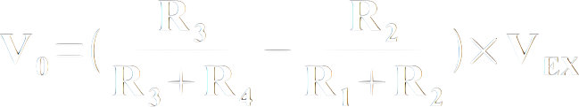
Wheatstone Bridge
How Does It Work?
R1
R4
+
-
VEX
V0
R2
R3
Notes:
• equation demonstrates the voltage change from a wheatstone bridge
• temperature does not effect V0
• example: R1 and R3 in compression and R2 and R4 are in tension

Slide 8
Load Cells
Compensation for Error
Hysteresis
  Effects reduced by material selection.
Creep
  Adhesive and geometry of gauge.
Temperature
  Wheatstone bridge, additional temperature sensitive resistors in series with the bridge.
Notes:
• hysteresis: inability to come back, (2) 5 lb - 5 lb > 5 lb
• tendency to continue increasing strain
• adhesive relaxes countering effects of creep

Slide 9
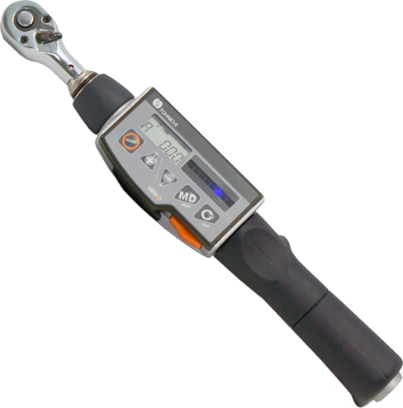
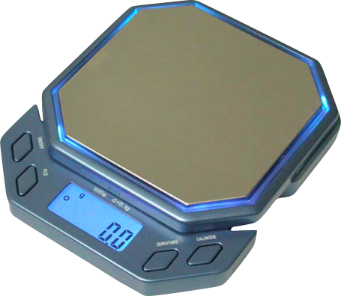
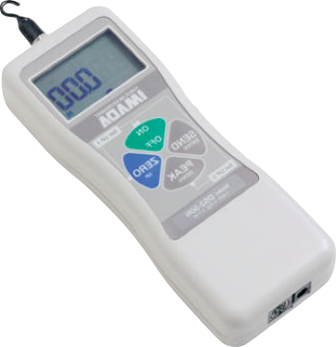
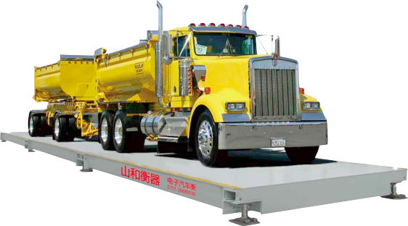
Load Cells
Applications
Scales
  Weighbridge
Force Gauges
Torque Gauges

Slide 10
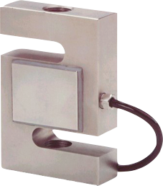
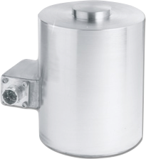
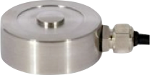
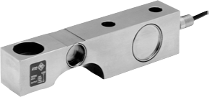
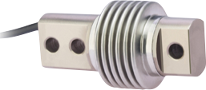
Load Cells
Types
Button
Canister
S Type
Shear
Beam

Slide 11
Load Cell Comparison
Strain Gauge Load Cells
Load Cell Type | Weight Range | Accuracy | Apps | Strength | Weakness
Bending Beam | 10-5k lbs | 0.03% | Tanks, platform scales | Low cost, Simples construction | Strain gages exposed
Shear Beam | 10-5k lbs | 0.03% | tanks, platform scales,off-center loads | Better sealing and protection
Canister | to 500k lbs | 0.05% | Truck, tank, track, hopper scales | Handles load movement | No horizontal load protection
Ring & Pancake | 5-500k lbs |  | Tanks, bins, scales | All stainless steel | No load movement allowed
Button & Washer | 0-50k lbs 0-200lbs typ. | 1% | Small scales | Small inexpensive | Loads must be centered

Slide 12
Load Cell Comparison Cont.
Mechanical & Other Load Cells
Load Cell Type | Weight Range | Accuracy | Apps | Strength | Weakness
Hydraulic | Up to 10,000,000 lbs | 0.25% | Tanks, bins, & hoppers | Takes high impacts, insensitive to temp | Expensive complex
Pneumatic | Wide | High | food industry, hazardous areas | Intrinsically safe | Slow response. Require clean, dry air
Helical | 0-40k lbs | 0.2% | Platform, forklift, wheel load | Handles off-axis loads, overloads
Fiber Optic |  | 0.1% | Electrical transmission cables | Immune to RFI/EMI
Piezo-resistive |  | 0.03% |  | Extremely sensitive, high signal output level | High cost, nonlinear output

Slide 13
Acknowledgement
Special Thanks To:
Michael Wyatt, Mechanical Engineer and Load Cell Specialist for providing demo Load Cell equipment and expertise.

Slide 14
References
General Info: http://en.wikipedia.org/wiki/Load_cell
Weighbridge: http://floorscale.com.cn/cheap-weighbridge/
Digital Scale: http://www.scales-n-tools.com/
Digital Torque Wrench: http://tohnichi.files.wordpress.com/2010/04/tohnichi-digital-torque-wrench
Load Cell Comparisons: http://www.omega.com/prodinfo/loadcells.html
Pictures of Load Cells:
  Shear: http://www.process-controls.com/intertechnology/Revere_Transducers/images/SSB.gif
  Beam: http://www.tradeindia.com/selloffer/1616481/Bending-Beam-Load-Cell.html
  S-Type: http://metrology.burtini.ca/img/stype.jpg
  Button: http://www.appmeas.co.uk/images/cdf-80x80.jpg
  Canister: http://www.omega.co.uk/literature/transactions/volume3/images/loadpic3.jpg
Compression/Tension: http://www.ishida.com/technologies/loadcell/html.html
Voltage Equation: http://zone.ni.com/devzone/cda/tut/p/id/3642
Resistivity Equation: http://en.wikipedia.org/wiki/Resistivity

